Slide 1







Ultrafast Laser Micro- and Nano- Processing group (ULMNP)
http://stratakislab.iesl.forth.gr/
Polarization-resolved Third Harmonic Generation Imaging Microscopy of starch
Maria Kefalogianni, Sotiris Psilodimitrakopoulos, Leonidas Mouchliadis, Emmanuel Stratakis
ULMNP, IESL, FORTH, Physics Department, University of Crete
Institute of Electronic Structure and Lasers (IESL)
Foundation for Research and Technology Hellas (FORTH)
ΜΑΥΑ
Brainprecision
These projects are carried out within the framework of the National Recovery and Resilience Plan Greece 2.0, funded by the European Union – NextGenerationEU (Implementation body for MAYA: HFRI)
Project Number: 0535850
Project Acronym: Brainprecision

Slide 2





Polarization-resolved Third Harmonic Generation in starch
Maria Kefalogianni
PhD candidate
                ULMNP, IESL, FORTH
                Physics Department,
                University of Crete

Slide 3
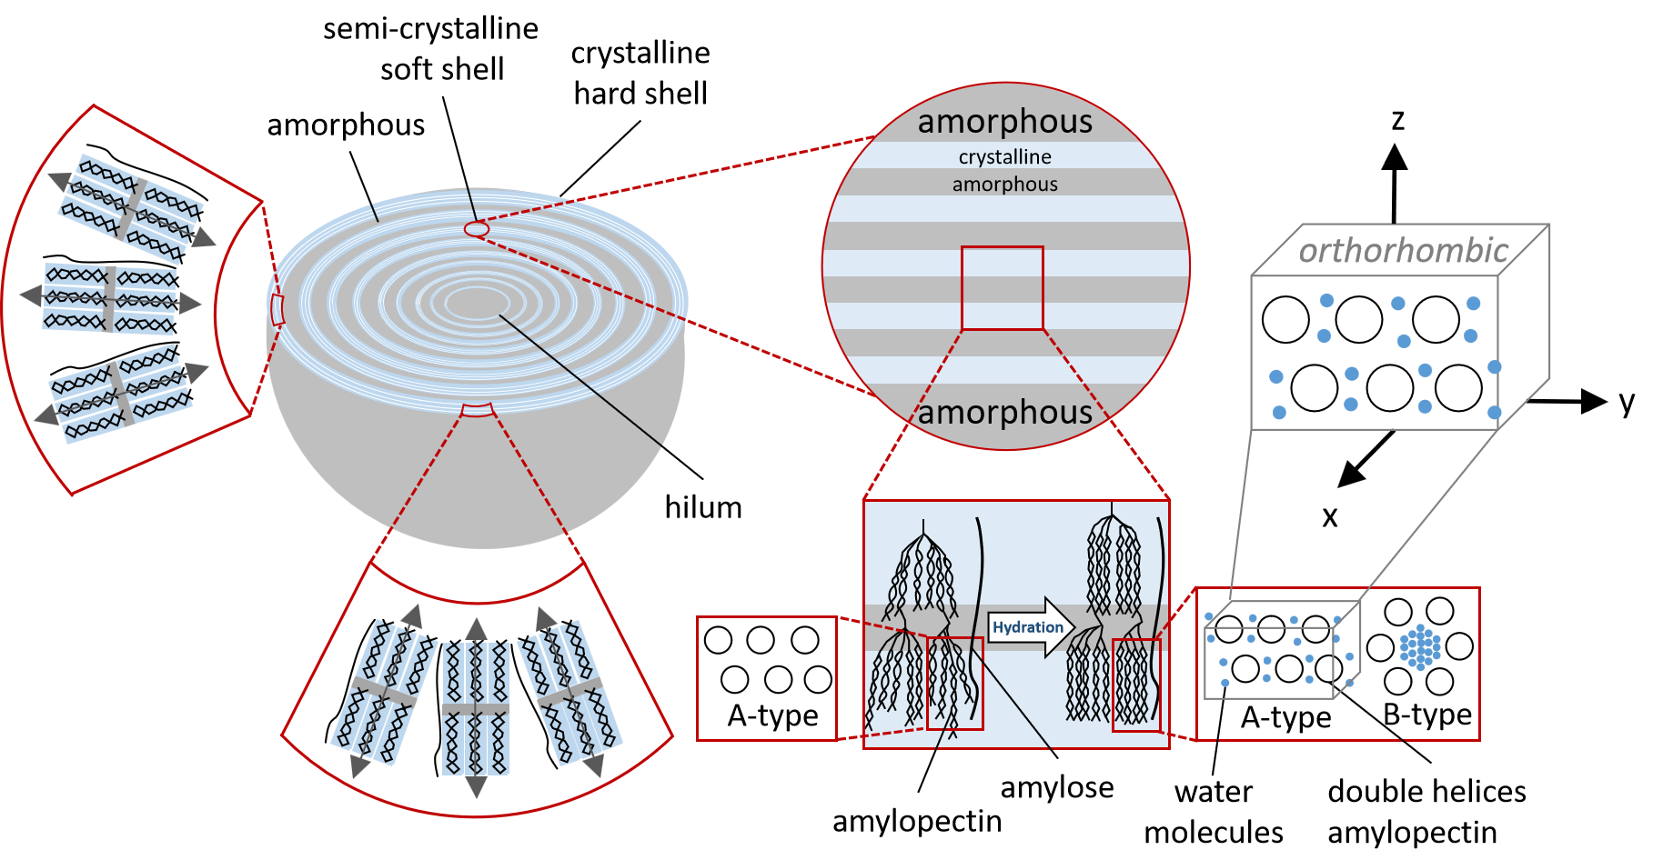
Structure of a hydrated corn starch

Slide 4
Motivation
Limitations of
Imaging Characterization Techniques
Biological Question
Starch serves as a major source of energy
Significant applications in food,
pharmaceuticals and biofuels industries
Need for understanding starch´s spatial organization and molecular alignment
Electron Microscopy Complex Sample Preparation
X-ray scattering Invasive Techniques
Nuclear Magnetic Resonance Low Resolution
Solution
THG / P-THG imaging technique
Label free technique, no need of marking
sub-micrometer resolution imaging
non-invasive, non-Linear excitation decay
Extract molecular structural morphology
Explore orientational properties

Slide 5
Goal of this Research
Utilize P-THG imaging microscopy :
Characterize molecular architecture of a hydrated corn starch granule
Identify the different orientational properties of the elementary orthorhombic starch structures acting as the THG sources

Slide 6
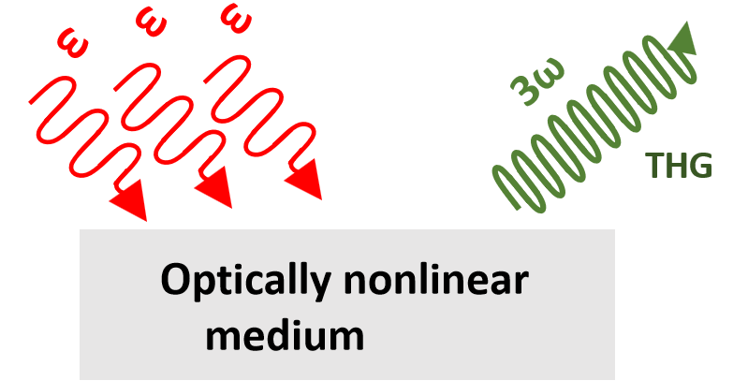
Principle of THG
Third Harmonic Generation
Incident photons fs Laser
ω
ω
Emitted photons THG
ω
3ω
χ^{﹙3﹚}

Slide 7



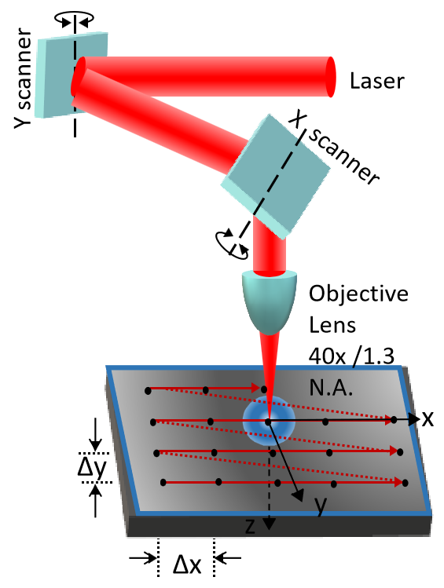
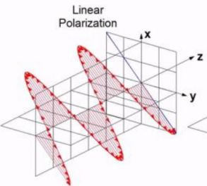
Material and Methods
Sample preparation
Setup
Polarizer
Filters
Mirror
Detector 1
Condenser
Lens
IR Laser
Laser-raster scanning
Sample
OPO
Objective
Lens
HWP
HWP
Telescope
Mirror
x-y scanner mirrors
THG - endogenous

Slide 8
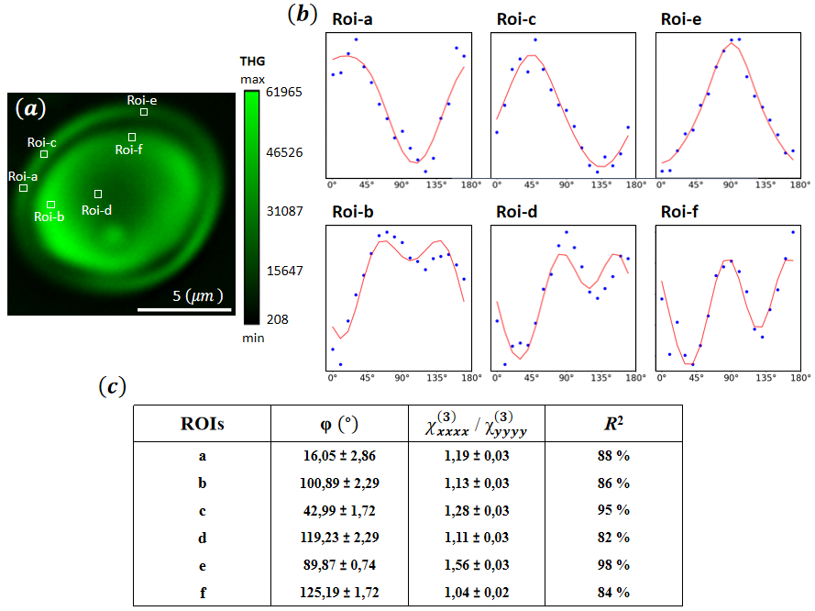
Results

Slide 9
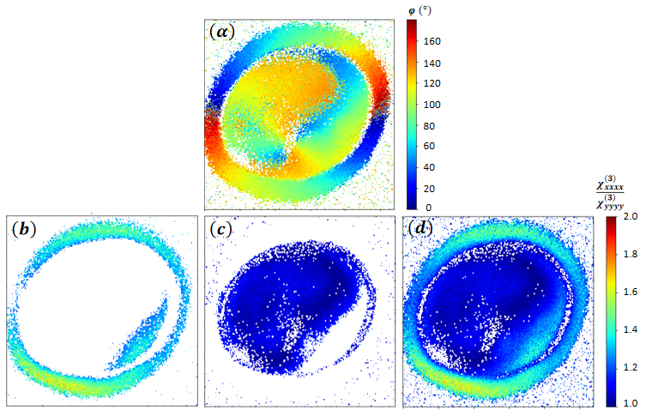
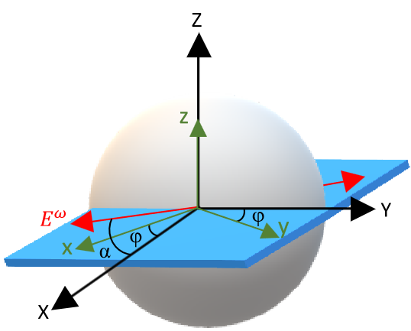
Results
Anisotropy Ratio
χxxxx/ χyyyy
y
x

Slide 10
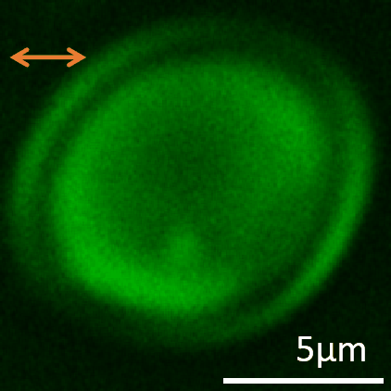
Results
P-THG imaging in starch

Slide 11
Conclusion
Conclusion
Label-free, non-invasive P-THG imaging technique applied to starch granules
Combination with a precise biophysical methodology, using a single equation to model the entire granule
Theoretical model assuming orthorhombic symmetry for the elementary THG source
Characterization of molecular distribution and mean orientational average of the molecular assembly inside the granule
Exploration of orientational properties within the elementary orthorhombic starch structure, which acts as the THG source
Discrimination of outer shell vs. inner regions in the hydrated starch granule

Slide 12


Thank you for attention!
ΜΑΥΑ
Brainprecision
These projects are carried out within the framework of the National Recovery and Resilience Plan Greece 2.0, funded by the European Union – NextGenerationEU (Implementation body for MAYA: HFRI)
Project Number: 0535850
Project Acronym: Brainprecision

